Slide 1
Machine Learning for Chip Design Automation
Mark Ren

Slide 2
Outline
Introduction to design automation
Applications of ML for design automation
Prediction: various ML models
Generation
Optimization
Conclusion

Slide 3

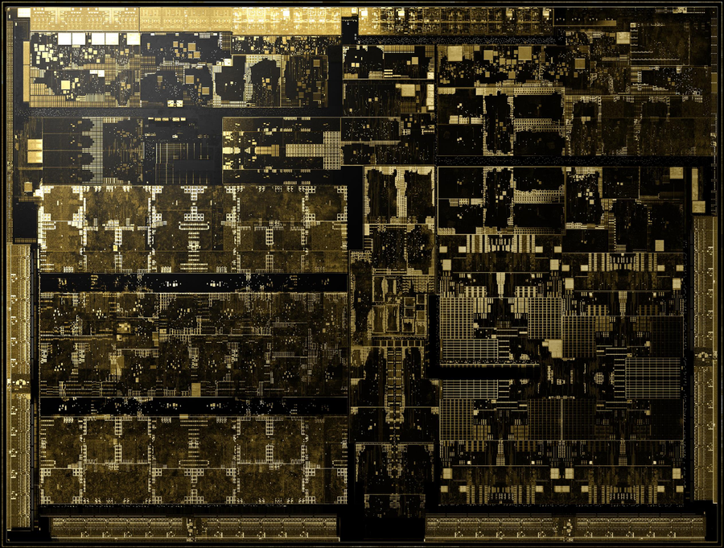

Design Automation
Code
Design Automation
9B transistors
350 mm² die size
TSMC's 12FFN

Slide 4
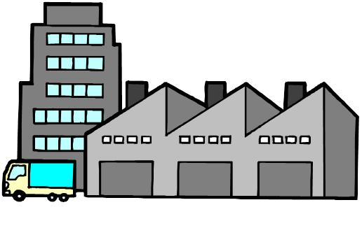


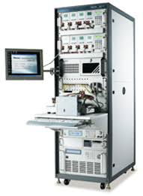
Design Automation Flow
Manufacturability
Synthesis& DFT
SystemC
Gate level netlist
Design Spec
High Level Synthesis
Physical Design
RTL
Layout netlist
Functional Verification
Testability

Slide 5
Macro Trend 1: End of Technology Scaling
Moore’s Law: transistor count doubles every 1.5 – 2 years
slow down and dead
Dennard scaling: P=CFV², frequency scales exponentially as V drops
Broken since 2005
How to improve design performance without technology scaling?
Better design ideas
Better design automation

Slide 6
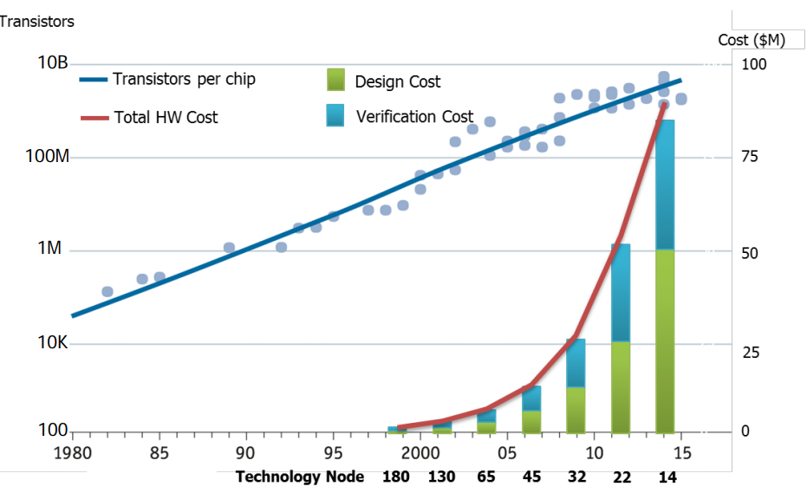
Macro Trend 2: Rising Design Cost
DARPA, ISPD 19
reduce design cost == improve design productivity => better design automation

Slide 7


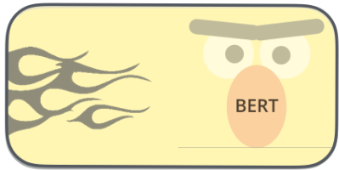
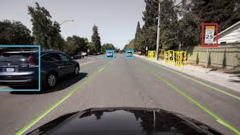
The Potentials of ML

Slide 8
Can we use ML to improve design automation QoR and Productivity?

Slide 9
ML for Design Automation
Prediction
Supervised Learning
Generation
Unsupervised Learning
Optimization
Reinforcement Learning
Notes:
Purpose and scope, answer with the Quote
Improve -> purpose, not for fun
Scope is pretty big → anything learning through experience -> scope; look into details of the scope, there are three ways
Model a complex process as a black box and predict the outcome from features
Supervised learning: regression, SVM, RF, CNN, RNN, FCNN
Intelligently explore a large feature space to find the optimal target
Active learning, Bayesian optimization, Genetic algorithms, Reinforcement learning
Learn to generate a target directly from features
Generative models/Unsupervised learning: autoregressive, auto-encoder, GANs
Unsupervised, labels

Slide 10
Prediction
Supervised Learning
DRC Prediction with Classical Machine Learning method
Power Prediction with Convolutional Neural Network (CNN)
DRC Hotspot Prediction with Fully Convolutional Network (FCN)
Testability Prediction with Graph Convolutional Network (GCN)

Slide 11
Classical Machine Learning vs Deep Learning
No need for feature engineering
Performance
Deep Learning
Machine Learning
Amount of Data
https://arxiv.org/ftp/arxiv/papers/1803/1803.01164.pdf
Notes:
First, let’s look at diference of classical ML and DL.
Classical ML has been applied to PD ….
For example, …
But deep learning can achieve … that is why
The other benefit … for example , the authors of
In this talk, I will focus …

Slide 12
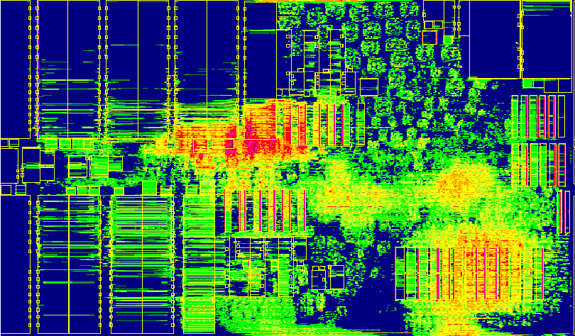
Congestion/DRC Prediction
RTL
Synthesis
Gate level netlist
Placement
Optimization
Routing
Routing Congestion → DRC Violation
Layout netlist

Slide 13
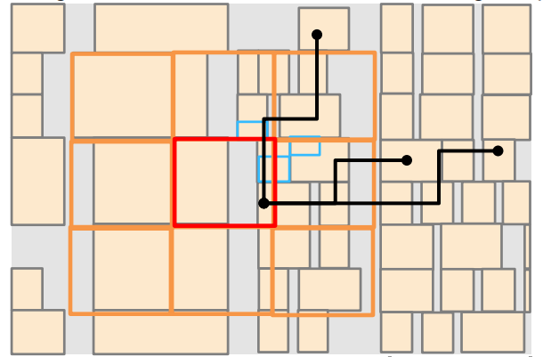
Predicting DRC from Placement
Model
Window based approach
Train SVM Classifier to identify DRC violation for each window
Collecting input features such as :
Pin density, cell density
Global routing resources
Pin proximity
Cell connectivity
Net spreading …
Routability Optimization for Industrial Designs at Sub-14nm Process Nodes Using Machine Learning, ISPD’17

Slide 14
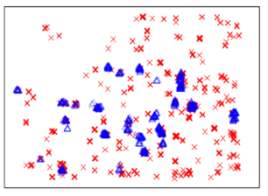
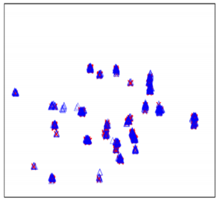
Predicting DRC from Placement
Results
GR-abased prediction
SVM-based prediction
Routability Optimization for Industrial Designs at Sub-14nm Process Nodes Using Machine Learning, ISPD’17

Slide 15
Power Prediction
SystemC
Slow (10-100 cycles/s)
High Accuracy
Fast (1k-10k cycles/s)
Low Accuracy
Gate Level Netlist
Predict gate level power with RTL or SystemC register traces
RTL
PRIMAL: Power Inference using Machine Learning (DAC’19)

Slide 16
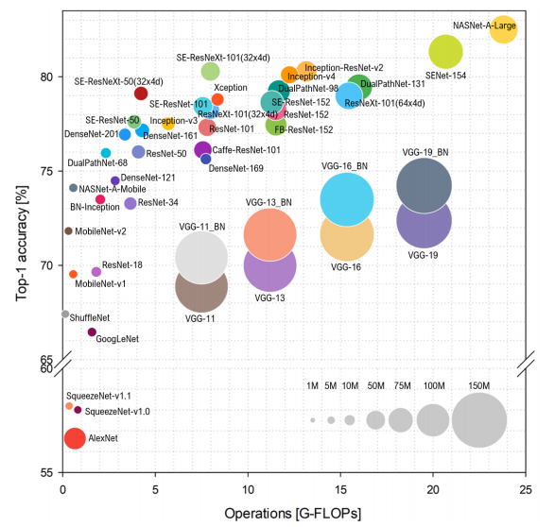
Fast CNN
ShuffleNet V2
https://arxiv.org/pdf/1810.00736.pdf
Notes:
The most successful DL model …
Many networks are developed…
This plot shows …
Generaly the higher the computing …
Let’s look at one of the efficient network …, inference speed of …

Slide 17
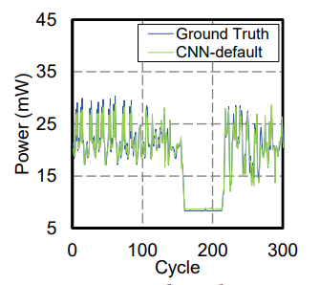
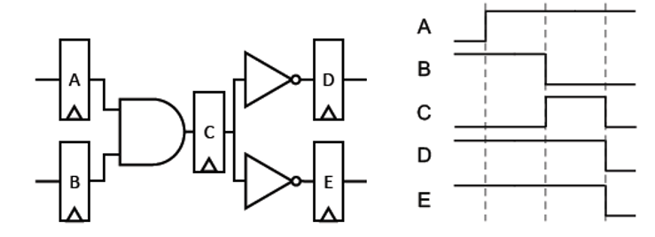
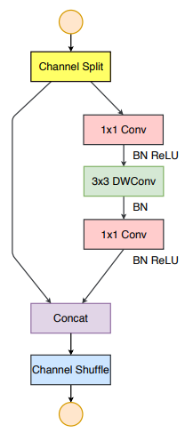
Power Prediction with Fast CNN
Fast & Accurate ML
C0: non-switching C1: 0→1
C2: 1→0
1K – 50K inferences/s
Reg-to-Pixel Mapping
A
B
C
1
0
0
D
E
0
0
1
1
1
0
0
0
1
0
0
0
0
0
0
0
0
0
0
0
0
0
0
0
ShuffleNet V2
PRIMAL: Power Inference using Machine Learning (DAC’19)
Notes:
Let’s look at a power prediction problem
Instead of extensive …., we would like a fast prediction …
To leverage well trained CNN netowkrs, we first ...
Then we apply the fast shufflenet on this image and replace …

Slide 18
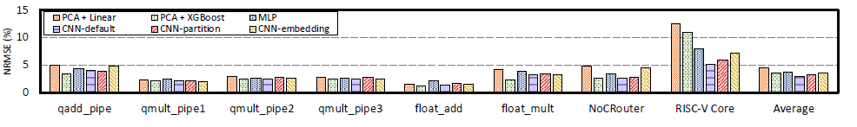
Power Prediction with Fast CNN
DL has better accuracy than ML for large design
Register 160 384 405 438 381 372 5651 23531
& I/Os
PRIMAL: Power Inference using Machine Learning, DAC’19
Notes:
We compared CNN models with other …
Most models shows similar in small …
But on large design ….
We tried different reg-to-pixcel mapping, and found not much diffence, which indeed proves ….

Slide 19
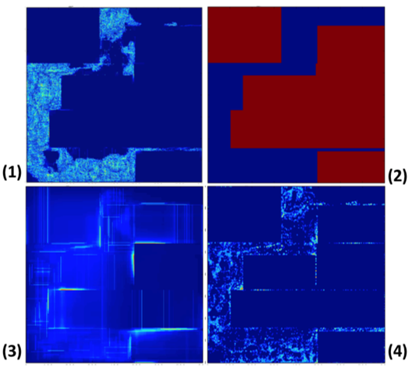
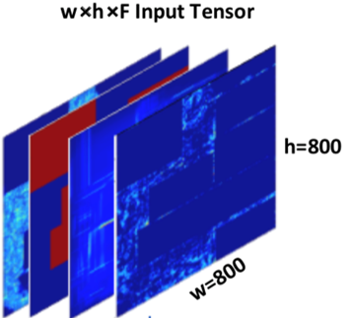
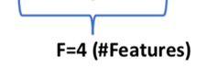
DRC Hotspot Detection
DRC Hotspot Map ?
Input tensor constructed by stacking 2D features:
(1) Pin density, (2) macro (3) long-range RUDY, (4) RUDY pins
ROUTENET: Routability Prediction for Mixed-Size Designs Using Convolutional Neural Network, ICCAD’18
Notes:
We apply this network to predict DRC hotspot in thi joint work with …
Previous work is window based ML
In this work, features of the entire design image is used to predict hotspot.
Feaures include. …. And they are are mapped into channels of images,.
And the output is an image …

Slide 20

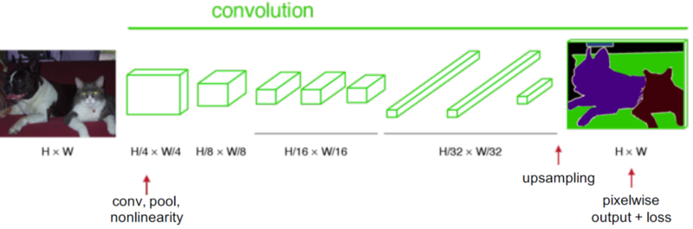
Fully Convolutional Network (FCN)
No Fully Connected Layers
Upsampling/Transposed Convolution
(Blue input, green output)
Fully Convolutional Networks for Semantic Segmentation, CVPR’15
Notes:
The second very popular …. Instead of predicting one…
The key difference is a upsampling …,
Most CNN layers keep the dimension, or reduce the …, upsampling actually increase the ….,

Slide 21
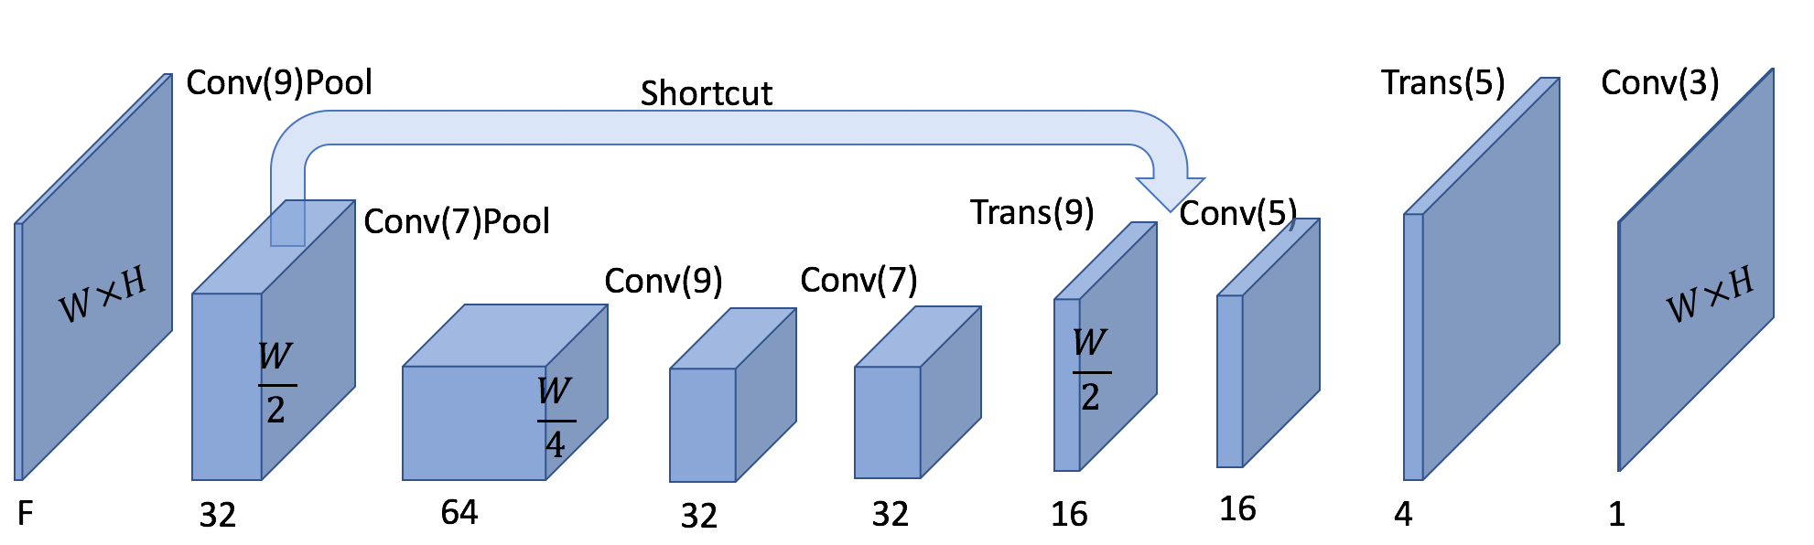
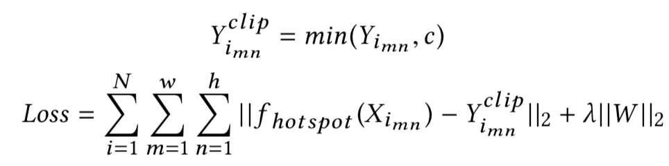
ROUTENET Model
Pixel-wise loss function
ROUTENET: Routability Prediction for Mixed-Size Designs Using Convolutional Neural Network, ICCAD’18
Notes:
Here is the detail of this model
Start with input feature maps, convolution, upsampling, shortcut …
Because the output is image , we can build cost function …

Slide 22
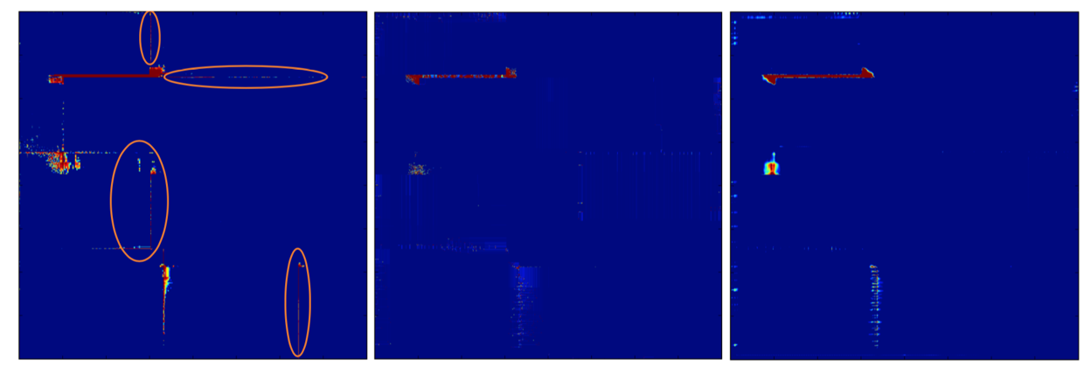
DRC Hotspot Detection Evaluation
Window-based ML
Ground True
RouteNet
ROUTENET: Routability Prediction for Mixed-Size Designs Using Convolutional Neural Network, ICCAD’18
Notes:
We compare the FCNN … ML window based
We can see ...

Slide 23
Chip Testing
100010
000101
100111
011101
010101
101111
001011
110101
?
010101
101111
001011
110101
010101
111111
001111
110101
Input patterns
Stuck-at-0 fault
output patterns
golden patterns
GND
Notes:
Not all the fautls can be easiy detected

Slide 24
Testability Problem
B’s faults unobservable → Difficult-to-test (DT)
Test Point (TP)
Stuck-at-0 fault
i9
B
i10
B’s faults are observable with an inserted register
GND
i0
O
i1
i2
Almost always 0
i3
i4
A
i5
i6
i7
i8
Almost always 0
Notes:
This the test point insertion problem

Slide 25
Testability Prediction with ML
Given a circuit, predict which gate outputs are difficult-to-test (DT)
Gate Features: [logic level, SCOAP_C0, SCOAP_C1, SCOAP_OB]
Gate Label: DT (0 or 1) generated by TetraMax
Input Features
N1: 0,0,1,1
N2: 1,0,1,0
N3: 2,0,1,1
.
.
.
Output classification
N1: 0
N2: 1
N3: 0
.
.
.
ML Model
Notes:
Due to the time limit, …
Unlike input features which can be obtained almost instantly, Take hours to get these labels
Predicting output classification from input node feature directly never going to work

Slide 26
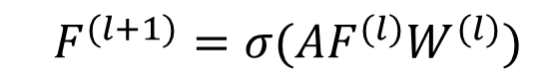
Graph Convolutional Network (GCN)
GCN aggregates information from neighboring nodes
1
3
2
4
9
8
$$F^{(l+1)}=σ(AF^{(l)}W^{(l)})$$
5
7
6
Aggregation (mean, sum)
Encoding (R^{m} → R^{n},Relu)
Semi-Supervised Classification with Graph Convolutional Networks, ICLR’17
Notes:
Similar idea can be apply to graph as well, which is called GCN
Aggregates
Encoding

Slide 27
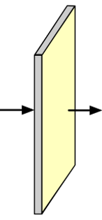
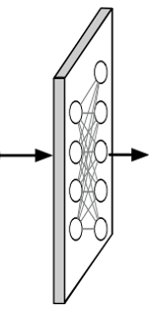
GCN based Testability Prediction
Logic Level SCOAP_C0 SCOAP_C1
SCOAP_OB
Layer 1
Layer 2
Layer 3
Fully Connected Layers
1
1
0
0
0
0
Weighted sum & Relu(R⁴ → R³²)
Weighted sum & Relu(R³² → R⁶⁴)
Weighted sum & Relu(R⁶⁴ → R¹²⁸)
(64,64,128,2)
High Performance Graph Convolutional Networks with Applications in Testability Analysis, DAC’19
Notes:
We apply GCN to a ….
Simple intreoduction of testability problem
The input … three gcn layers, .. Fully connected, output

Slide 28
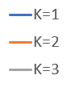
Testability Prediction Accuracy
K: # GCN Layers
Test point insertion reduced by 11% over TetraMax.
Graph based model well-suited for EDA problems.
High Performance Graph Convolutional Networks with Applications in Testability Analysis, DAC’19
Notes:
With this network, we achieved ….
Compared to classic machine learning …
we also see increasing accuracy when increasing …
Althought this is testability application, because physical design ….

Slide 29
Generation and Optimization
OPC mask generation with Generative Adversarial Network (GAN)
Logic optimization with Reinforcement Learning

Slide 30
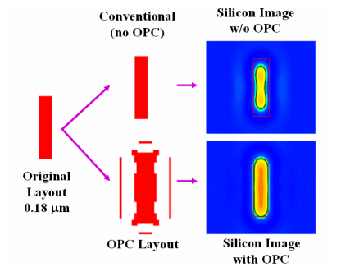
Manufacturability Problem : Optical Proximity Correction (OPC)
Optical Proximity Correction (OPC)-Friendly Maze Routing, DAC’04

Slide 31
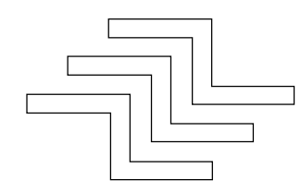
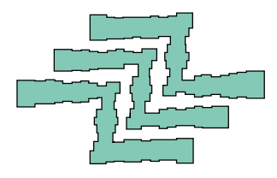
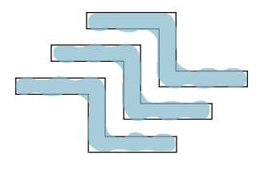
Inverse Lithography Transform (ILT)
ILT very time consuming
Design target
Mask with OPC
ILT
Wafer

Slide 32
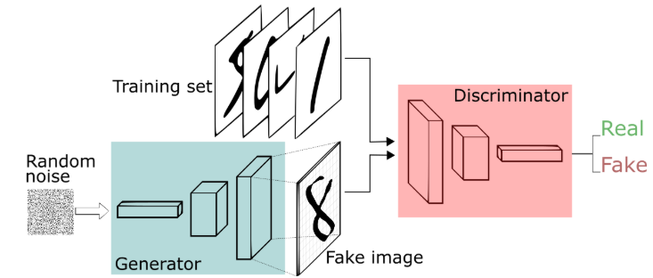
Generative Adversarial Network (GAN)

Slide 33
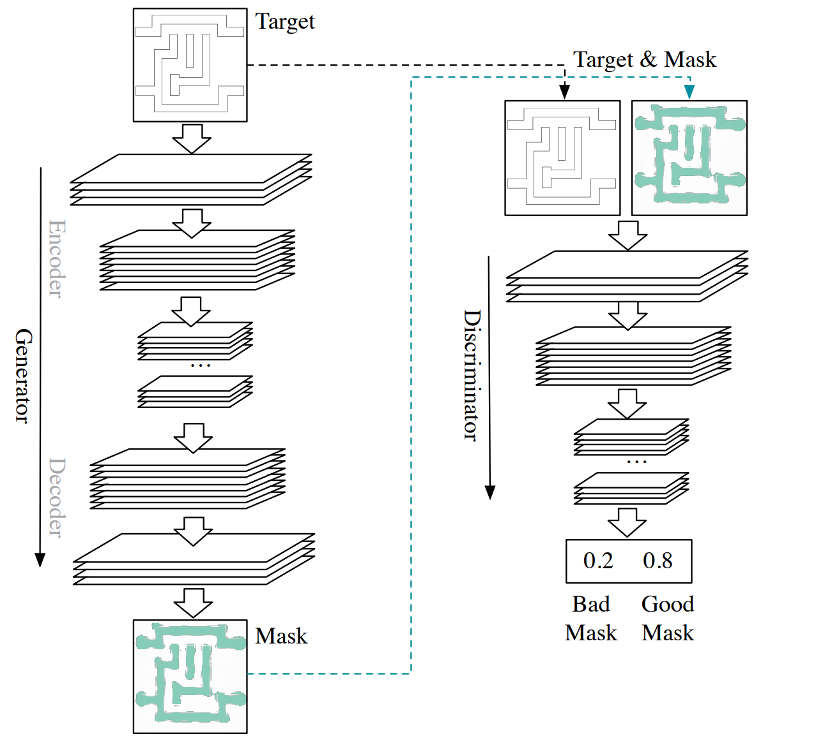
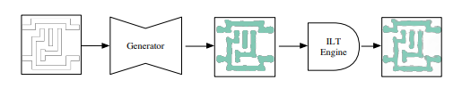
OPC-GAN
GAN-OPC : mask optimization with lithography-guided generative adversarial nets, DAC’18
Notes:
One of the pioneering work in applying generative mode ….
In this work, the author trying to solve …
Tranditionally , opc mask is computed with …
In this work, they proposed to use …. Generator, discriminator …
It is more of an application of autoencoder

Slide 34
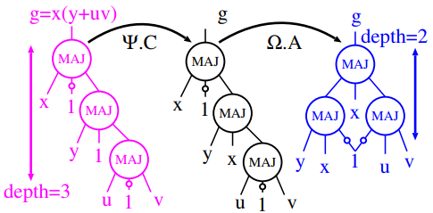
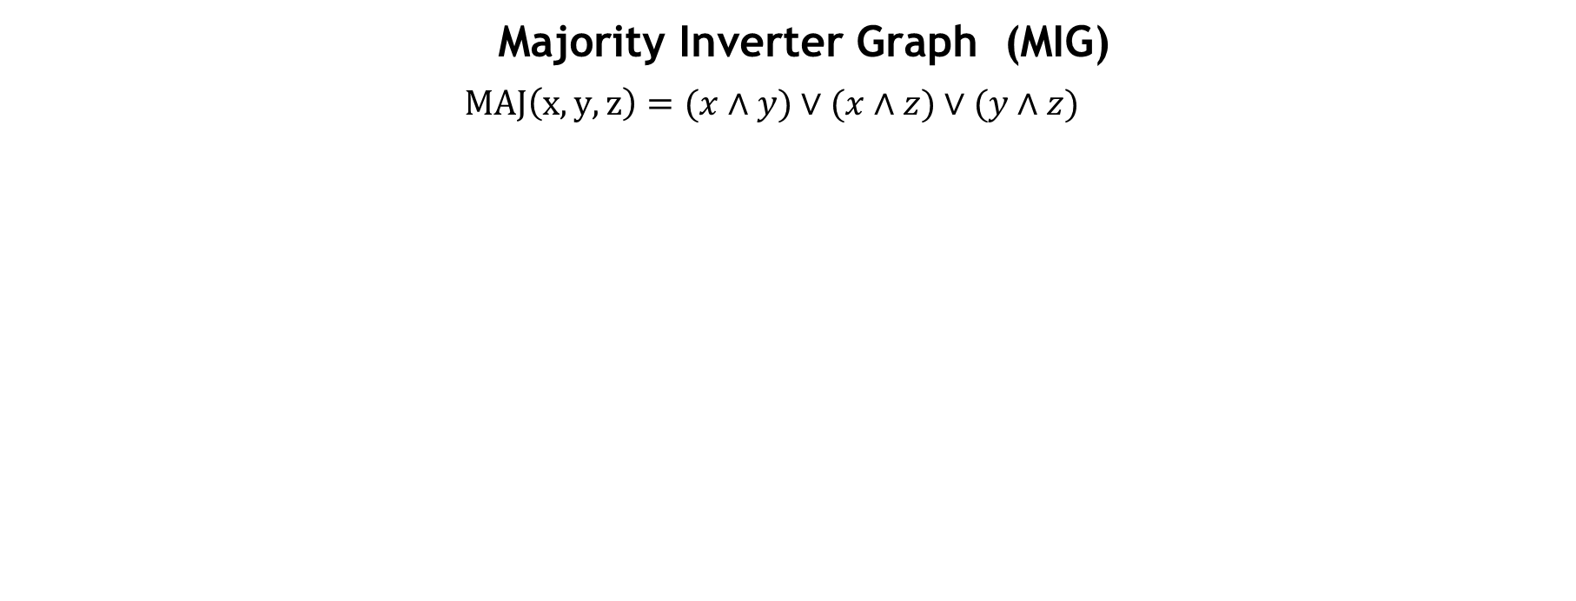
Logic Optimization
Reducing logic depth with logic transforms
Majority Inverter Graph (MIG)
$$MAJ\left(x,y,z\right)=(x∧y)∨(x∧z)∨(y∧z)$$
Complementary Associativity – Ψ.C
Associativity – Ω.A
Deep Learning for Logic Optimization, IWLS’17
Notes:
Complementary Associativity
Assoicativity

Slide 35
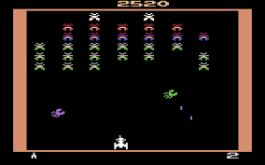



Reinforcement Learning Background
Reward $R(t)$: score you earned at current step
State $S$ : current screen
Action $a$: move your board left / right
Action value function $\hat{Q}(S, a)$: your predicted future total rewards
Policy $π(s)$: How to choose your action

Slide 36
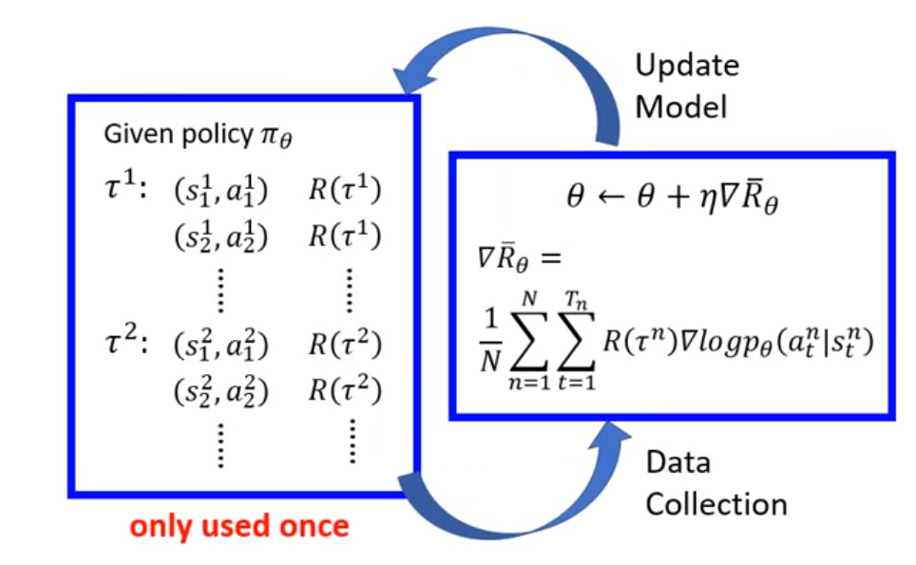
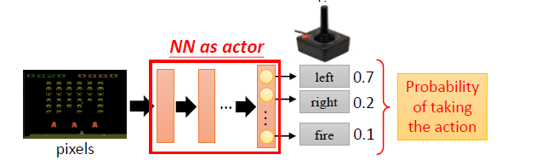
Policy Gradient
Hung-Yi Lee, Deep Reinforcement Learning, 2018
Notes:
Advantages:
Better convergence properties
Eective in high-dimensional or continuous action spaces
Can learn stochastic policies
Disadvantages:
Typically converge to a local rather than global optimum
Evaluating a policy is typically inecient and high variance

Slide 37
Policy Gradient For Logic Optimization
Stochastic policy to select optimization transforms
RF Formulation
Reward: logic depth reduction
State: current graph, use GCN to learn graph state
Action: which move to select
Policy: compute probabilities of each move given a state
Deep Learning for Logic Optimization, IWLS’17
Notes:
Complementary Associativity
Assoicativity

Slide 38
Fruitful Design Automation Areas for ML Methods
Do not create a problem just for ML
Intractable or High Complexity
No Analytical Solution
Make Conventional EDA Algorithm Smarter
Really Hard Problems
Notes:
What areas that traditional computation methods can not do well?
High computation complexity
No analytical solution
Examples
Computation complexity: NP problems, Full Chip FinFET Self-heat Prediction
Hardware correlation: System-level di/dt Noise Prediction for Test
QoR prediction: DRC prediction at placement
Design space exploration: HLS parameter tuning, circuit optimization, Neural architecture search
Design flow productivity enhancement: Verification coverage enhancement
Make conventional EDA algorithm smarter
Replace hand crafted heuristics: synthesis transform configuration, combinatorial optimization
Application of reinforcement learning and unsupervised learning in EDA have potential in the future
Analog layout generation, verification, design generation

Slide 39
Conclusions
Deep learning and machine learning can improve quality and productivity of design automation in many ways.
We should focus on innovative methods to apply advanced DL models to hard Design Automation problems
There are still a lot of challenges in applying DL : open dataset, transferability, interpretability

